Slide 1
Measuring Recovery Data for Active Persons
Garrett Fairbanks, Tyler Hayik, Oreva Omodior, Coopey P. Young

Slide 2
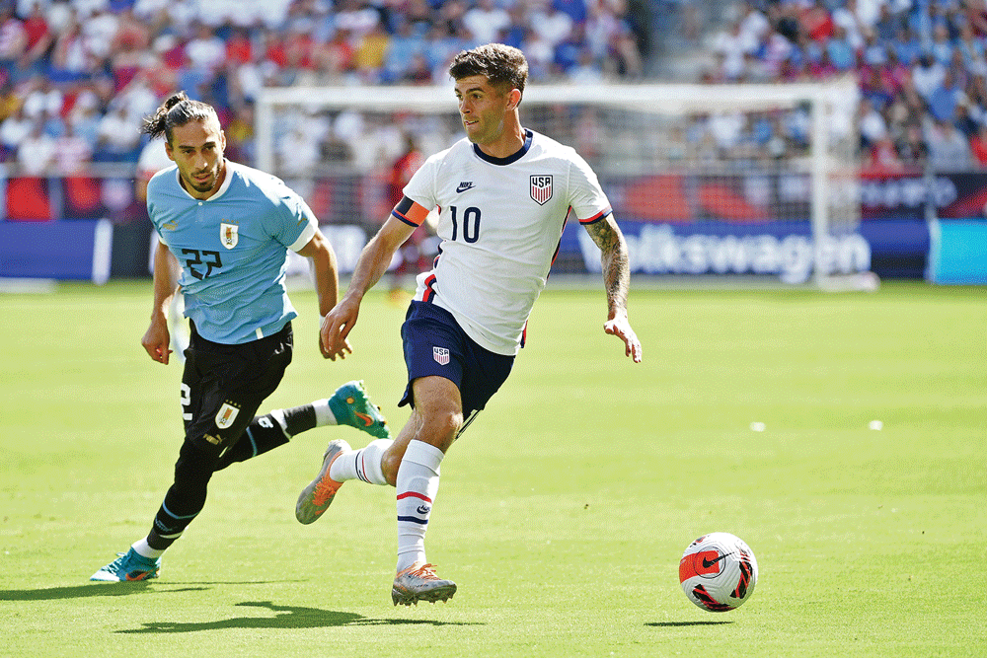

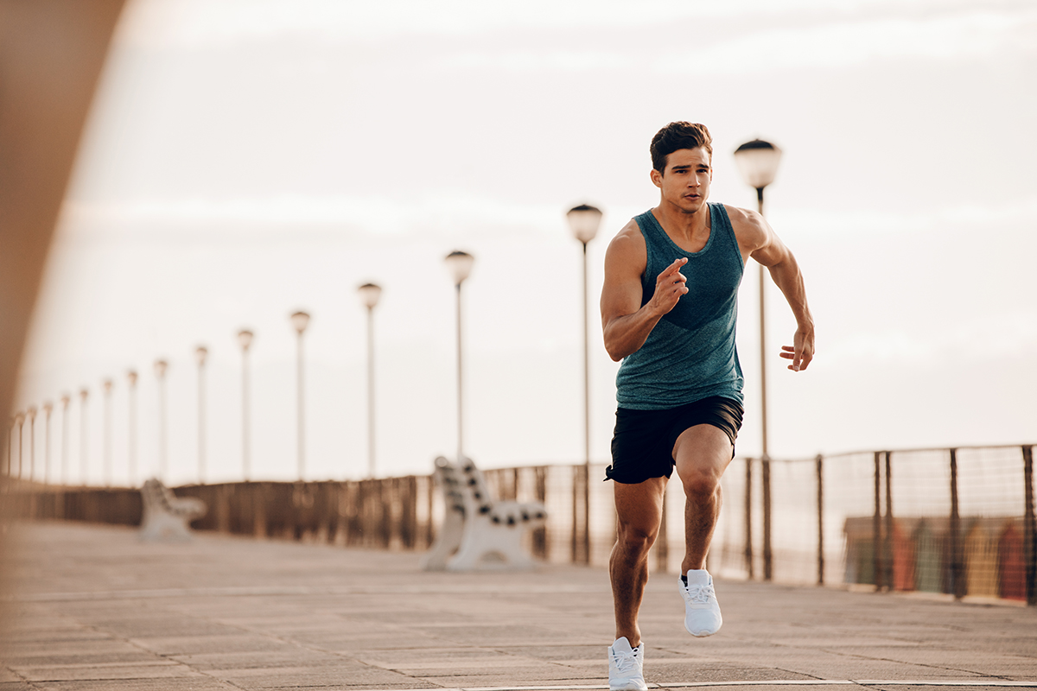
Motivation
One of the most important parts of overall physical performance is the post-workout recovery period. Our group members all had some interest in athletics, and we were heavily intrigued by the prospect of diving deeper into improving our subpar athletic abilities.
The interest expanded infinitely, in interesting ways, after the initial dive into interesting territory. The results of this project proved to be very interesting.
Notes:
Tyler

Slide 3
Initial Research
Heart rate / heart rate variability were seen as most reliable metrics for recovery
The heart is the most accurate place to measure heart rate / hrv
ECG data contains necessary information
Notes:
Oreva

Slide 4
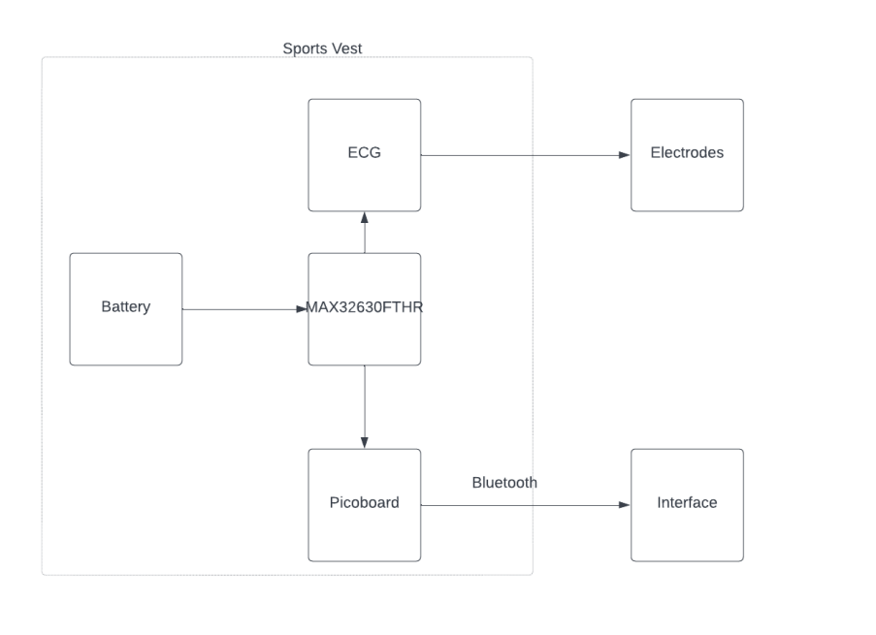
Concept
Notes:
Cooper

Slide 5
Roles
Garrett: Receiving, classifying and interpreting data from the sensor using Matlab.
Oreva: Designing and producing vest/encapsulation
Tyler: Implementing the hardware and the encapsulation
Coopey: Configure hardware and troubleshooting
Notes:
Everyhbody

Slide 6
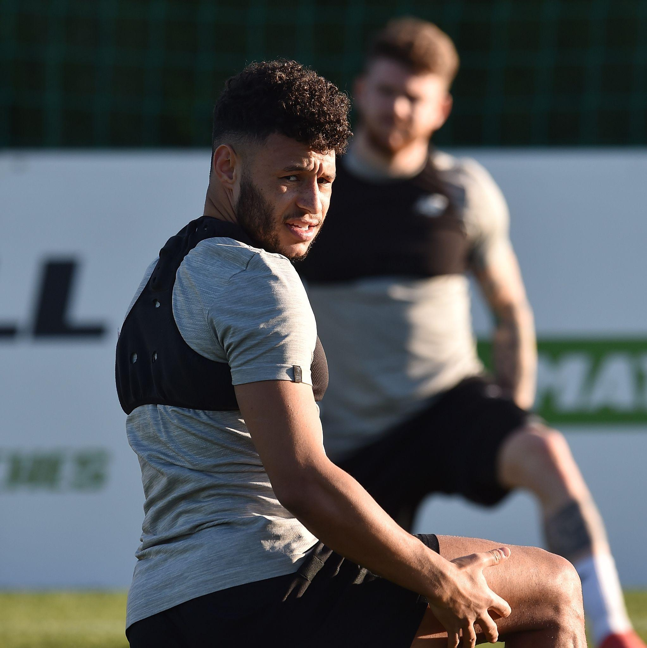
Attempted Design
Wanted lightweight, comfortable, and water-resistant design to encase hardware
Vest design similar to existing physical activity related tracker designs
Goal was to have a wireless connection from the host computer, use a battery to power the microcontroller
Notes:
Oreva

Slide 7
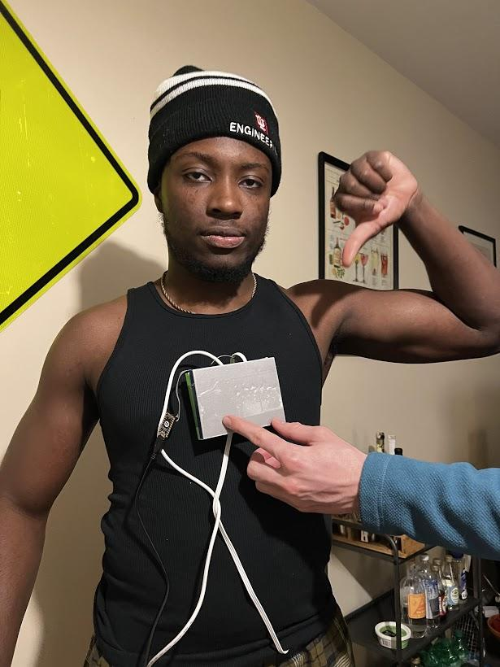
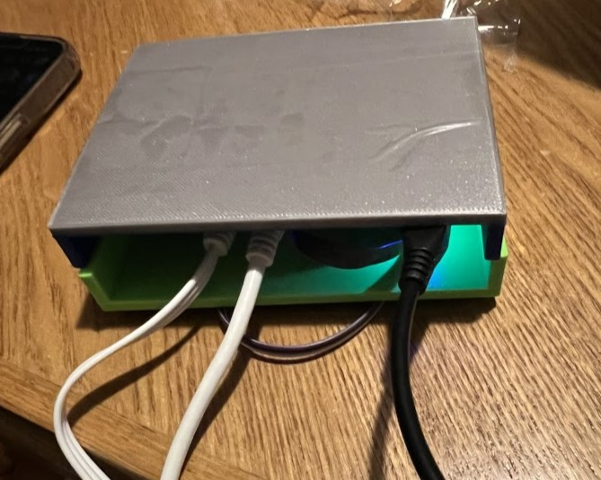
Actual Design
Click here to add text
Notes:
Oreva

Slide 8
Ideal Trial
Perform tests on multiple subjects
Subjects resting resting heart-rate and heart-rate variability are retrieved prior to physical activity
Subject performs physical activity for controlled amount of time
Heart-rate and heart-rate variability data retrieved immediately after physical activity
Analysis and interpretation of results
Notes:
Cooper

Slide 9
Actual Trial
Subject has electrodes attached to body and resting heart rate is calculated.
i) Subject rest for 10 seconds
ii) perform a jog in place for 10 seconds
iii)rest for 40 seconds
Compare difference in heart rate and heart rate variability after exercise is complete.
Notes:
Cooper

Slide 10

Demonstration

Slide 11
Code Implementation
Averages heart rate and heart rate variability (HRV)
Dynamic heart rate and HRV
Done by averaging 10 second intervals of the raw ECG data
Time-domain
HRV taken using RMSSD
As it stands currently, the code works best with 60 seconds of ECG data. Depending on the subject or what is being done, slight code modifications may be appropriate.
Notes:
Garrett

Slide 12
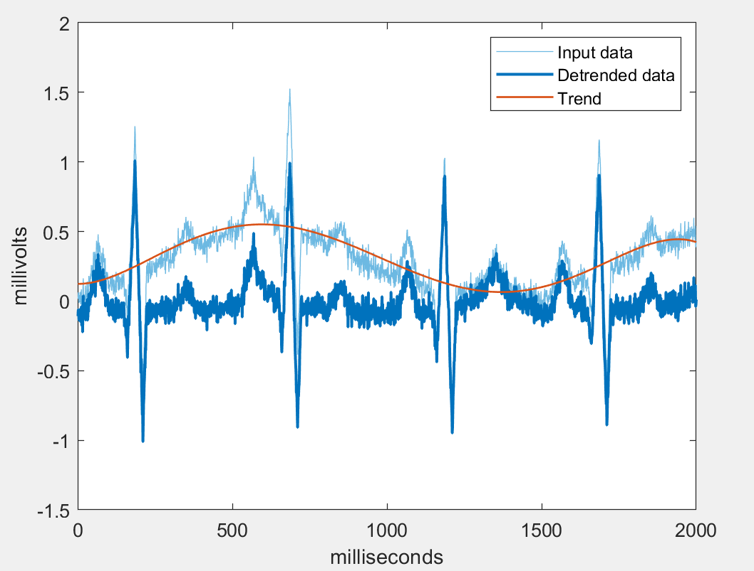
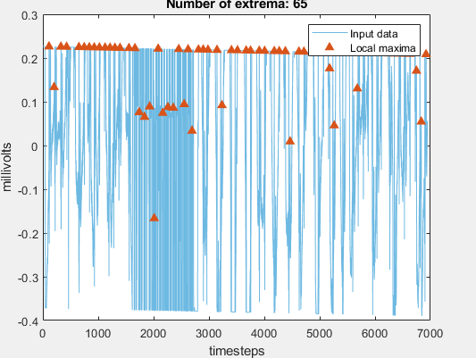
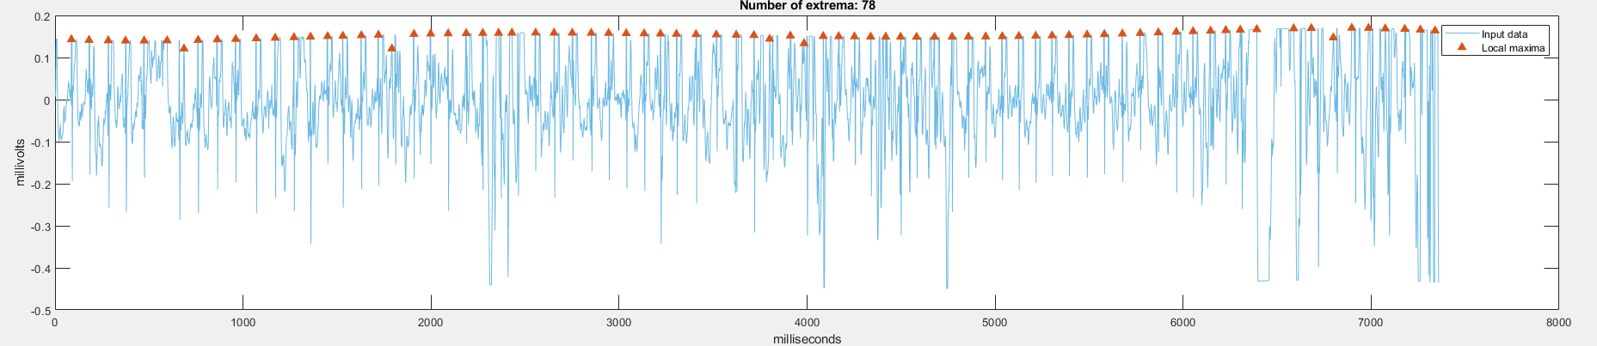
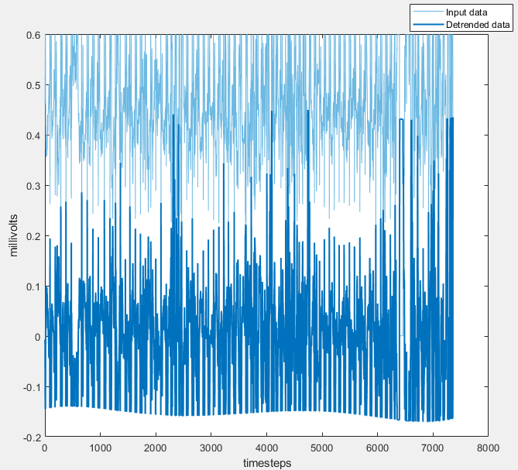
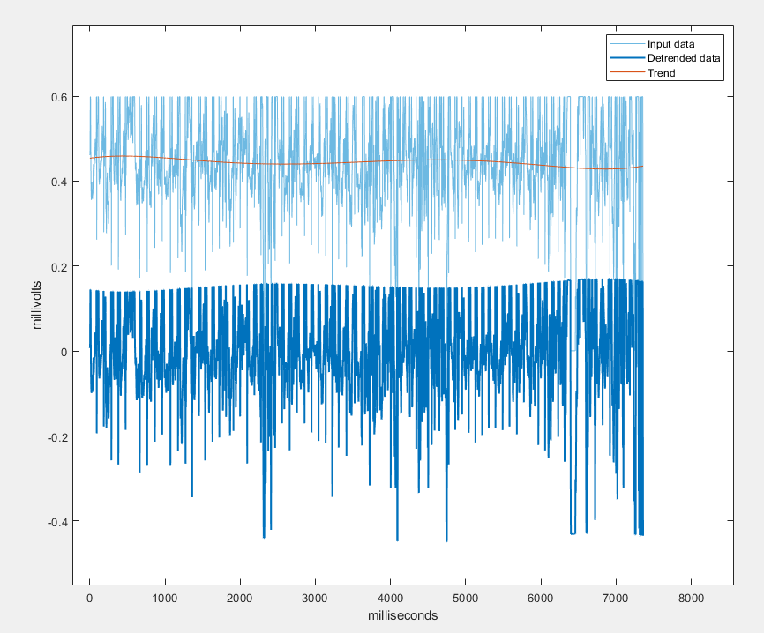
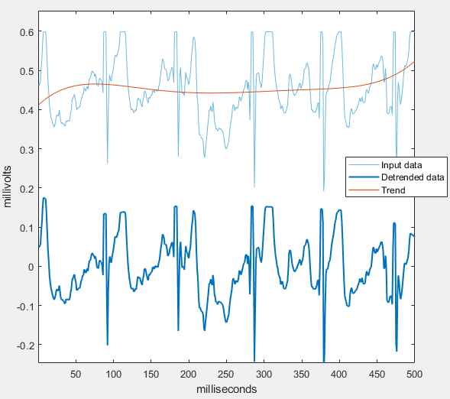
Sounds easy but actually it’s not easy at all

Slide 13
Problems - Voltage Limiting
Close-up Zoomed-out

Slide 14
Problems - Double Peaking (R classifying)
Ideal Received Data

Slide 15
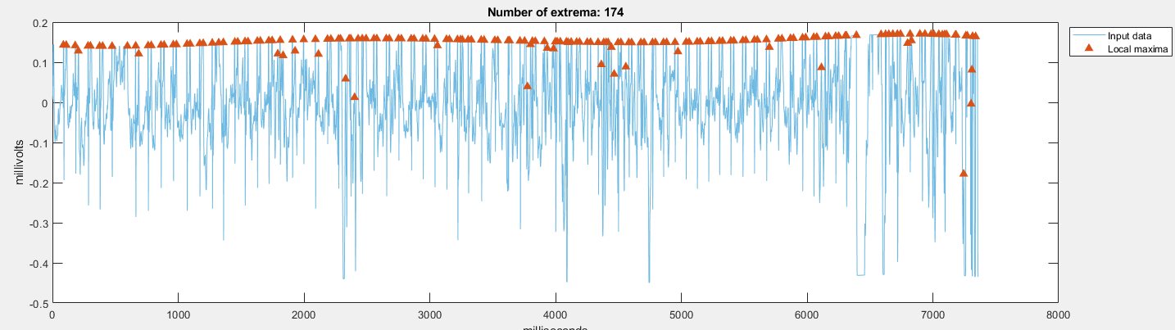
Solution - Identifying Flatlines
Before
After

Slide 16


Outcome
We managed to test the resting HR of 2 of our team members, then compared those with post-workout measurements.
Oreva
HR:
DHR:
DHRV:
Notes:
Garrett

Slide 17

Tyler
HR:
DHR:
DHRV:

Slide 18
Future Improvements
Implement bluetooth and a battery to eliminate the messy wires.
A better suited encasing which holds all the items in place.
Gather more data from a wider range of subjects
Collecting better and more accurate data
Notes:
Tyler

